Slide 1
Toronto Traffic Collision Prediction Model
By: Rakeen Ahmed

Slide 2
Agenda
Project Overview
Data Overview
Data Exploration/EDA and Data Visualization
Modeling
Collision Risk Map
Feature Importance
Feature Interpretation
Recommendations
Questions

Slide 3

Project Overview
Background
Problem Statement
Objective

Slide 4
Background
Traffic Collisions: Major public health concern in cities worldwide today
No. 1 cause of mortality between ages 15-29
Toronto Stats:
3ʳᵈ leading cause of mortality
1,581 deaths in the last 10 years

Slide 5
Background
Vision Zero Program
Goal: Eliminate deaths and serious injuries resulting from collisions
Toronto lags behind behind major European and American cities in terms of road safety
Approach: ”Data Driven insights based on past collision data to inform road design and infrastructure improvements”

Slide 6
Problem Statement
The project arose from a need to provide data-driven insights to inform road design and infrastructure improvements
The goal is to identify the key drivers of collision risk in terms of street design and infrastructure
Data sources: road infrastructure

Slide 7
Objective: Develop a collision prediction model for the City of Toronto
Goal:
Estimate and map the risk of traffic collisions on a given road and identify high-risk road segments
Identify the key design and infrastructure features driving collision risk to inform design changes.
Method: Utilize road infrastructure (bike lanes, traffic cameras, speed limits), design, and historical collision data
Result: Understanding key factors driving collision risk will inform effective design changes and lead to reduced collision
Objective

Slide 8
Data Overview
Data Sources
Merging Datasets
Exclusions

Slide 9

Data Sources
Toronto Centreline Road Network
All Traffic Collisions
Traffic Volumes
Centreline Lanes
Automated Speed Enforcement
Cycling Network
Pedestrian Crossings
Traffic Calming
Traffic Cameras
Posted Speed Limits
Sensitive Zones
KSI

Slide 10
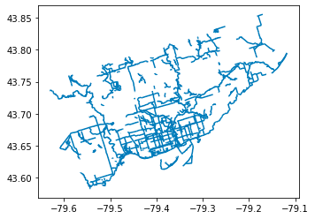
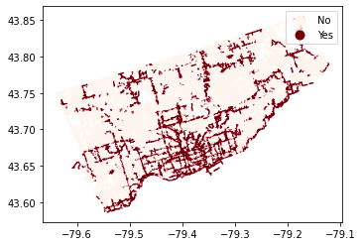
Merging Datasets
Datasets were merged using a spatial join using GeoPandas using exact or radius search.
Toronto Road Network was used as the base dataset
Get design and infrastructure features for all road segments for our prediction model.

Slide 11
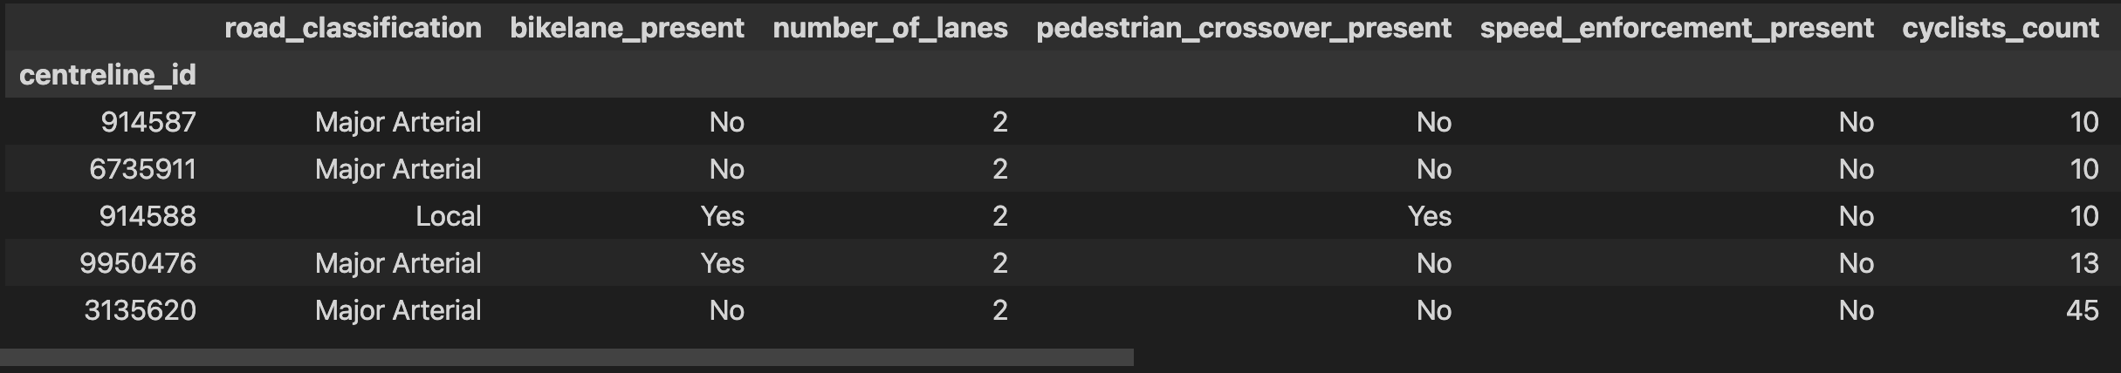
Final Dataset & Exclusions
Final Dataset contained 13,979 rows and 26 columns. (All features not shown)
Excluded all collisions before 2016 from the collisions and KSI datasets.

Slide 12
EDA & Data Visualization
Feature Engineering
Data Visualization

Slide 13
Feature Engineering
Collision Rate: The rate of collision of a road segment,
Derived from the total count of collisions divided by 1000 road users (pedestrians, vehicles, trucks etc.)
Measure of frequency of collision on each road segment by traffic volume
Collision Class: Bins of collision counts for use in classification models.
Speed Hump Present: Converted speed hump count to a flag

Slide 14
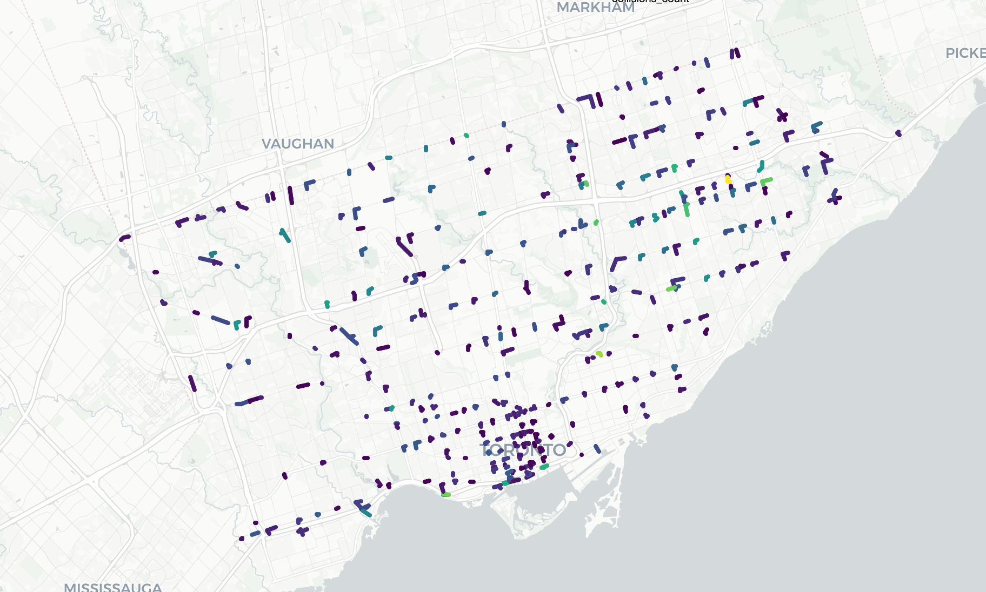
Data Visualization
Road Segments with the highest number of collisions

Slide 15
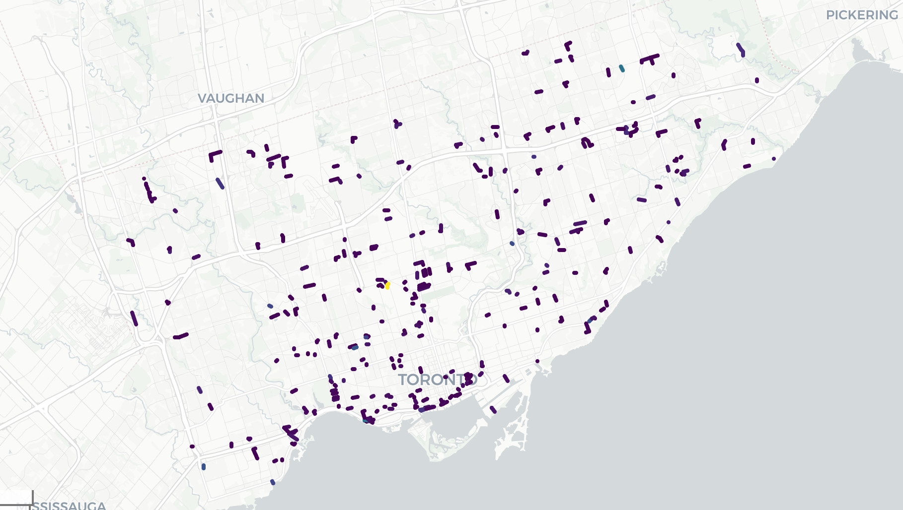
Data Visualization
Road Segments with the highest collision rates.

Slide 16
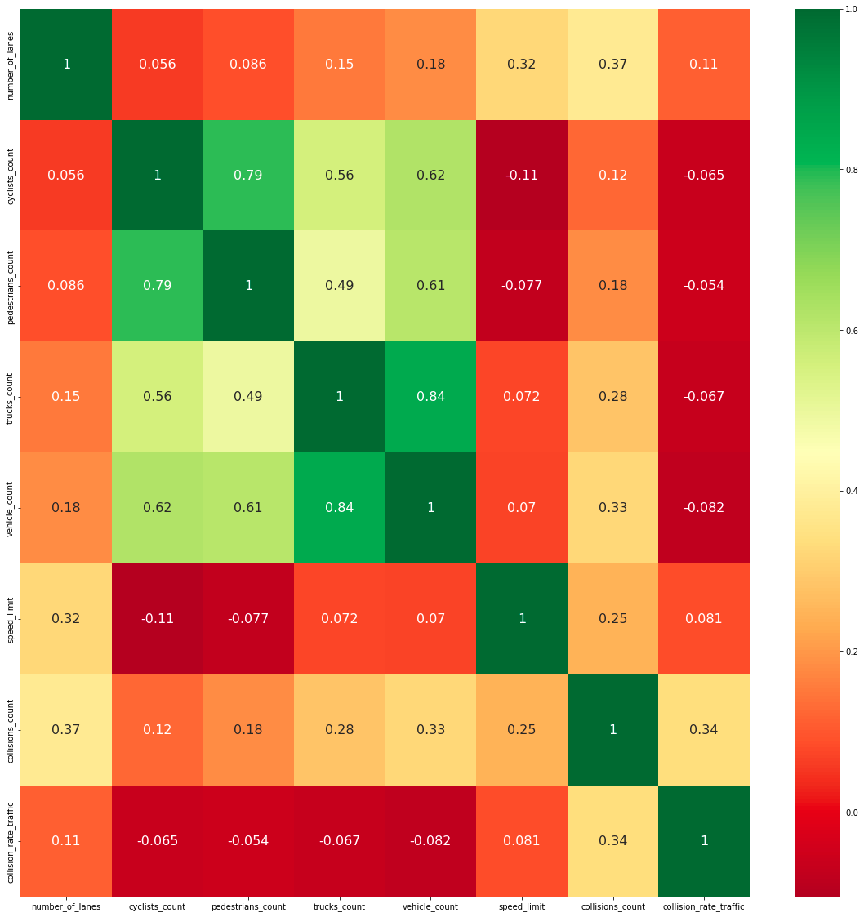
Data Visualization
Correlation Matrix

Slide 17
Modeling
Algorithms
Modeling Breakdown
Metrics
Model Comparison
Model Selection

Slide 18
Algorithms
Decision Tree
Random Forest
Neural Network
AdaBoost
Linear Regression
Logistic Regression
KNN
XGBoost

Slide 19
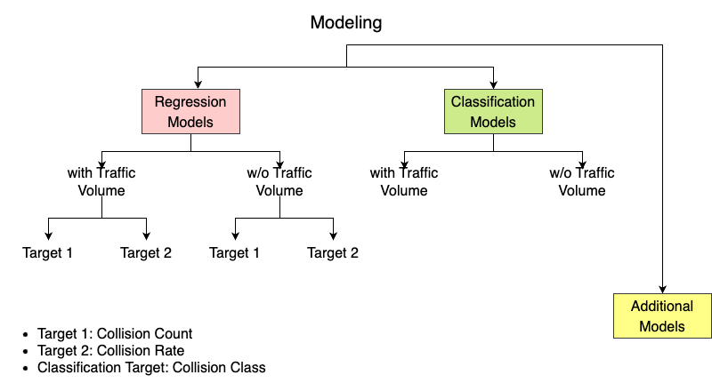
Modeling Breakdown

Slide 20
Regression Models
Mean Absolute Percentage Error
Average percentage difference between the actual and predicted values
Normalized Mean Absolute Error
MAE measures the average absolute difference between the actual and predicted values
MAE divided by the range of y-values to to normalize the error
Normalization enables comparison between diff. target variables
Classification Models
Accuracy
Metrics

Slide 21
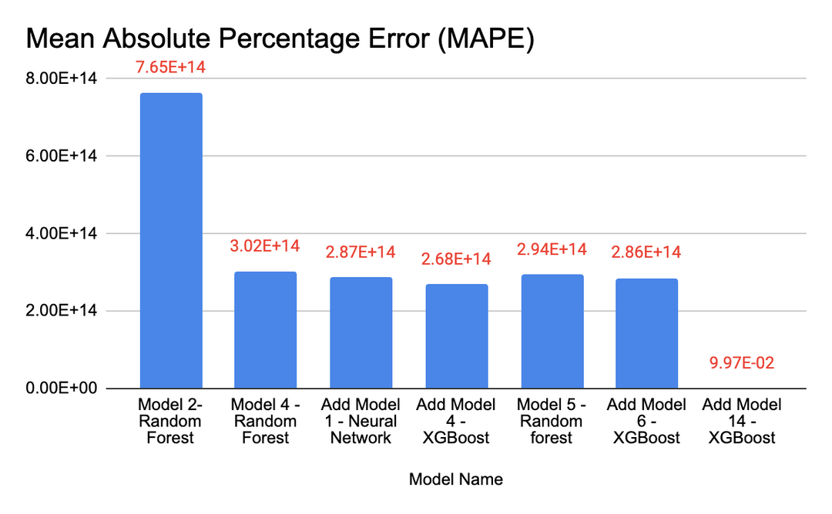
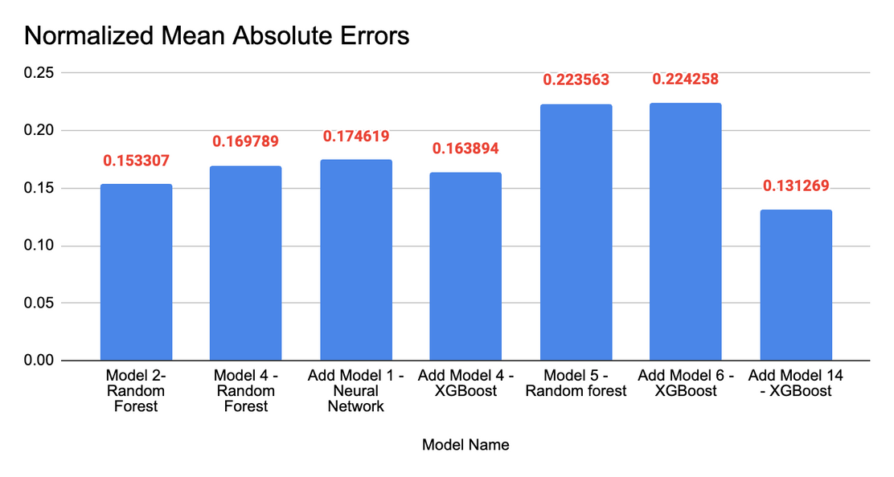
Model Comparison - Regression

Slide 22
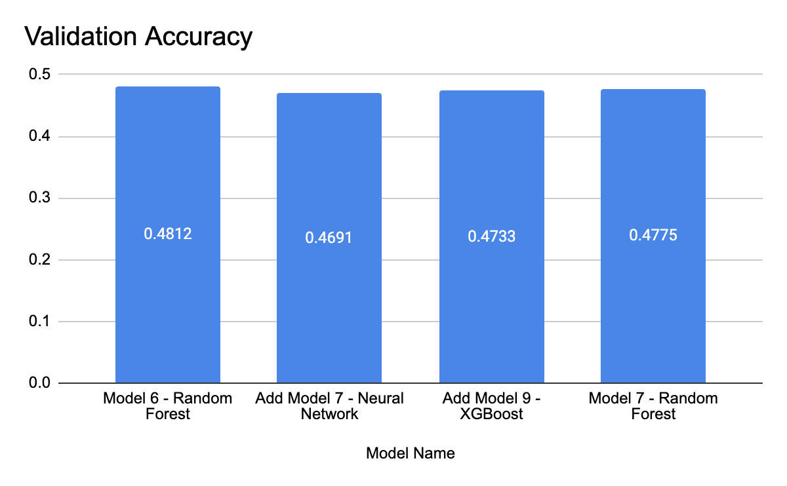
Model Comparison - Classification

Slide 23
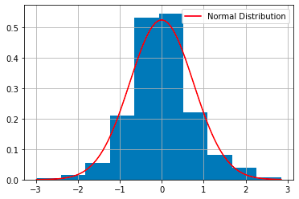
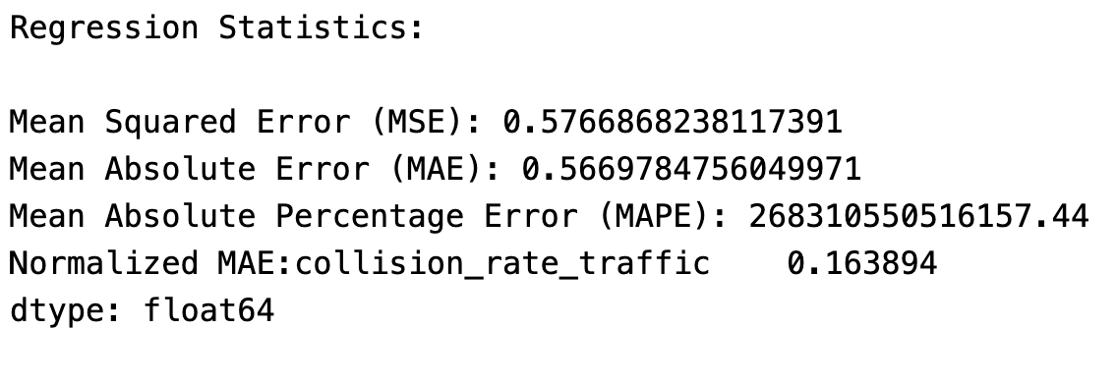
Model Selection
Add Model 4 – XGBoost was selected as the best model as it had a combination of low MAPE score as well as low Normalized MAE.
Regression model preferred.
XGBoost Models are very fast to train.
Residuals of the model are normally distributed.

Slide 24
Collision Risk Map

Slide 25
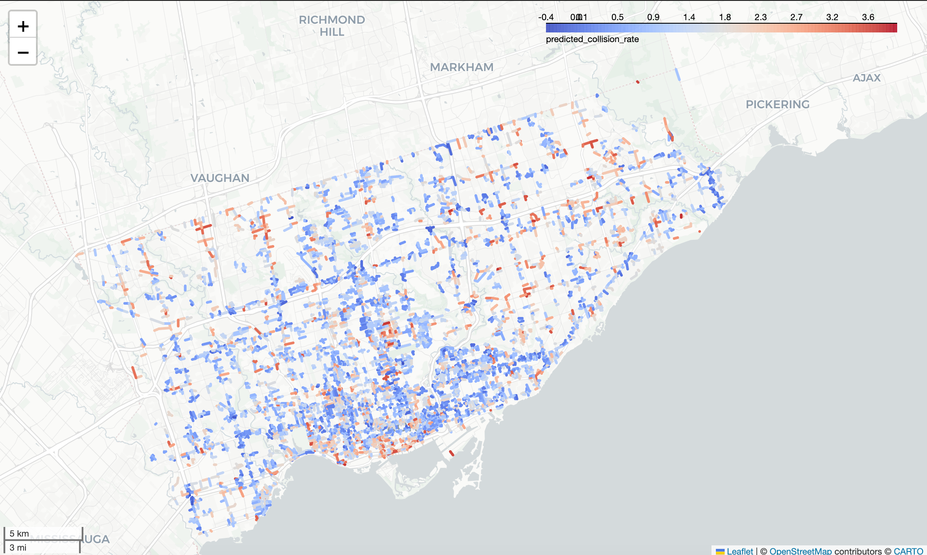
City of Toronto

Slide 26
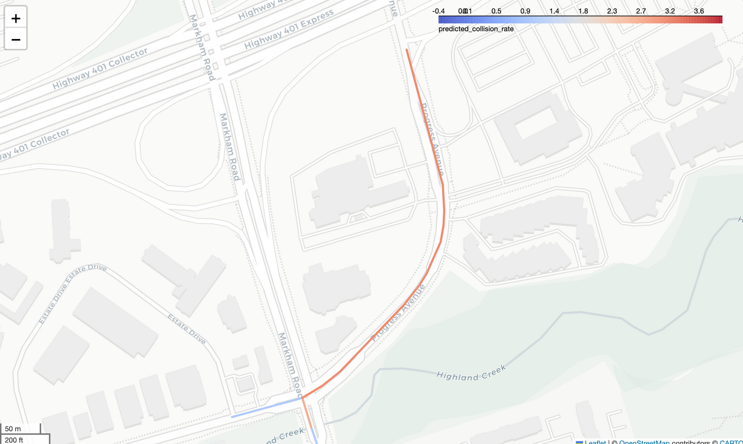
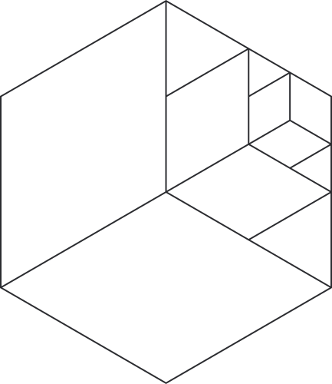
Centennial College
COLLISION RATE
Predicted: 3.01 per 1000 road users
Actual: 3.44 collisions per 1000 road users
COLLISION COUNT
Predicted: 150 (Collision Cap)
Actual: 624

Slide 27
Feature Importance
Best Model
High Collision Rate Segments

Slide 28
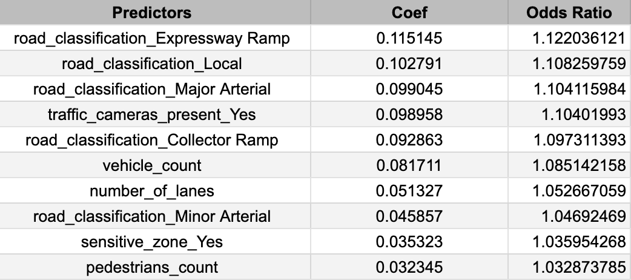
Feature Importance of Add Model 4 - XGBoost
Feature Importance – Best Model

Slide 29
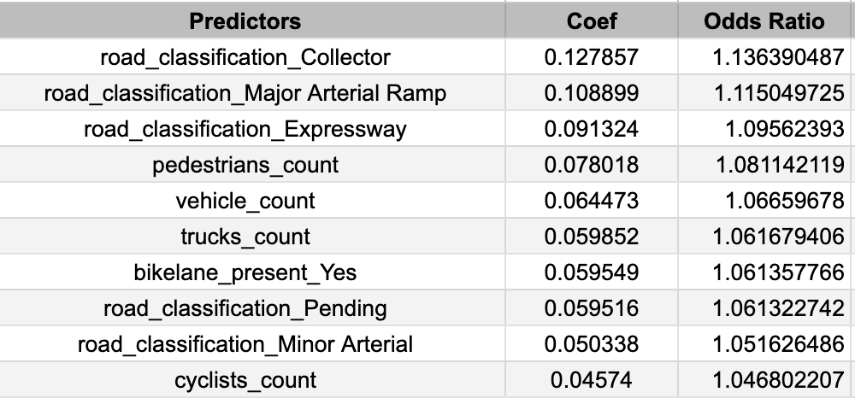
FEATURE IMPORTANCE – HIGH COLLISION RATE
Feature Importance of Add Model 14 - XGBoost

Slide 30
Feature Interpretation

Slide 31
Feature Interpretation
Road Classification: Major Arterial – 1.10
Road Classification: Minor Arterial – 1.04
Vehicle Count – 1.08
Number of Lanes - 1.05
Collision rates are 10% higher on Major Arterial Roads as compared to all other road classes.
Collision rates are 4% higher on roads classified as Minor Arterials.
For each additional 1000 vehicles on the road segment, the collision rate increases 8%.
For each additional lane on the road segment, the collision rate increases 5%

Slide 32
Recommendations
Recommendations
Future Work

Slide 33
Recommendations
Toronto Traffic Services should focus on these road segments:
Road Classification: Major or Minor Arterial
High Vehicle Count
High Number of Lanes
Use the collision prediction model to identify road segments that require design and safety improvements.

Slide 34
Future Work
Include additional road features in the model – Avg. Traffic Speeds, Traffic Signals, 311 requests
Develop separate collision models – Roads with high collision counts or high pedestrian counts, downtown vs suburbs.
Map collision risk for all road segments in Toronto.

Slide 35
Thank you!

